Slide 1
Bitcoin Trend Analysis Group Project
Team Boa: Brandie Parker, Charlotte Coolidge, Jong Kim, Junki Ogawa
UPenn Data Science Bootcamp
Notes:
Why/how we chose bitcoin

Slide 2
Core message/Hypothesis
What correlates to Bitcoin price?
Bitcoin price in relation to:
Nvidia stock price
Gas Price
Temperature at Bitcoin mining centers
Google Search Trends
What skyrocketed Google trend search of Bitcoin in November 2017?
NYT trending articles
Notes:
We first started with trying to compare Tweets of Elon
Questions we found interesting and what motivated us to answer them
Is bitcoin too volatile? Is it a good investment short/medium/long term?
How accessible is it for entry first time investors ?
Can we provide explanations on Bitcoin highs/lows?

Slide 3
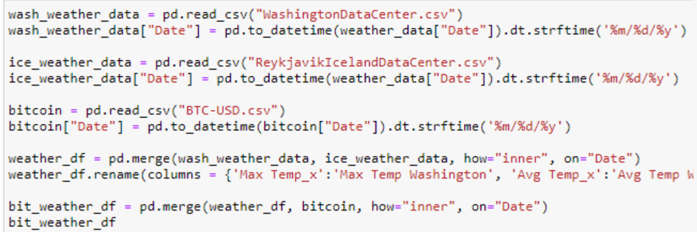
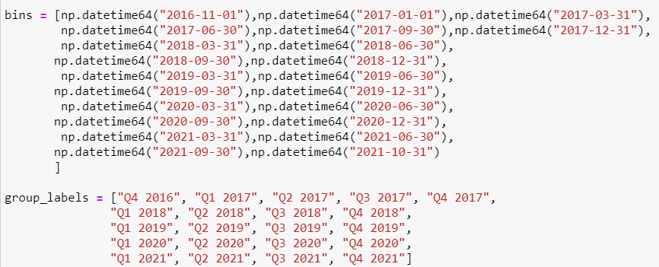
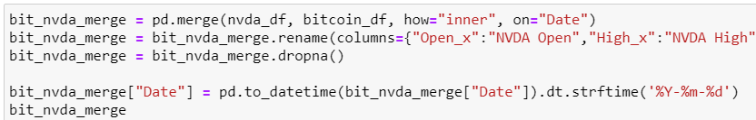
The data exploration and cleanup process
Data Collection
Kaggle
Open Weather API
Yahoo Finance
NYT API
US Energy Information Administration
Data Cleaning and Scrubbing
Match datatypes
Match formats of dates
Dropna
Binning

Slide 4
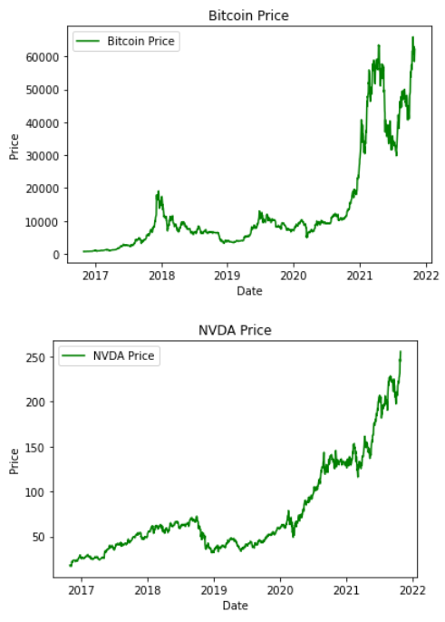
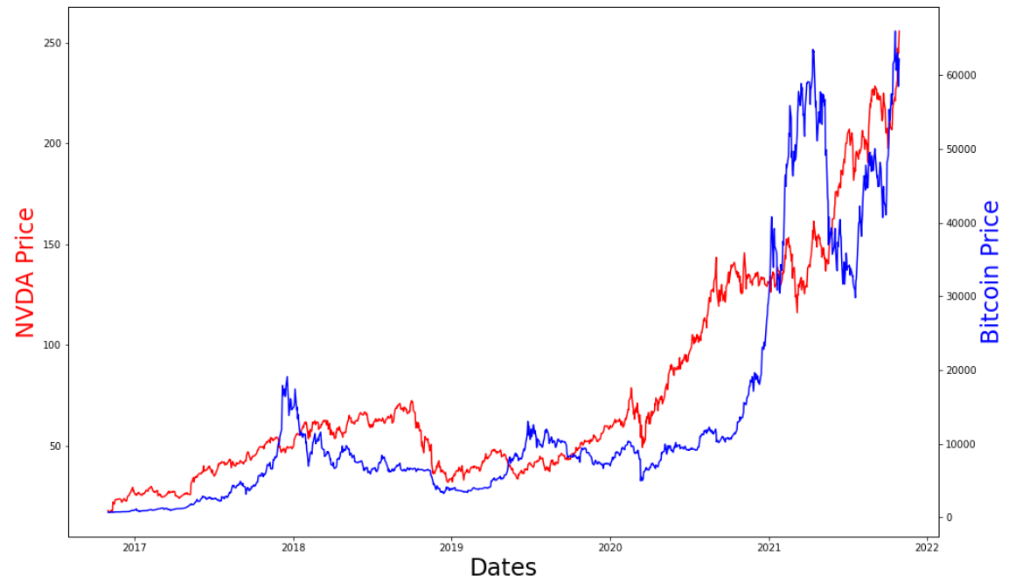
NVIDIA Stock Compared to Bitcoin Price

Slide 5
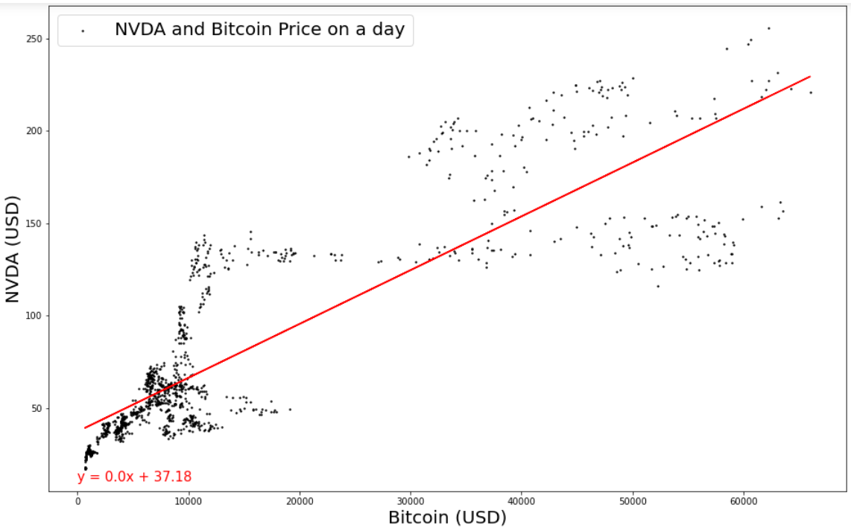
NVIDIA Stock Compared to Bitcoin Price
r value = .85
Strong positive correlation

Slide 6

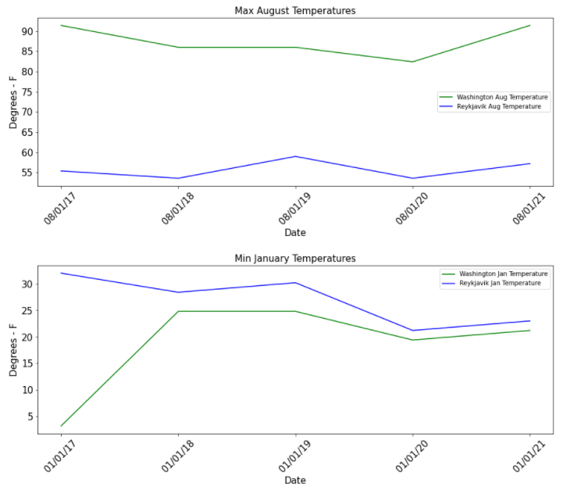
Are there environmental impacts of crypto currency: Temperature
Giga Watt Inc opened in 2017. We also see a significant temperature increase in January in subsequent years in East Wenatchee.
Genesis Mining opened in 2013, though we see the opposite trend in Reykjavik January temperatures.
Notes:
These countries, and regional areas are being incentivized from an economic perspective to house and run these massive data mining centers (as with the case in Iceland, this business represents 1% of their GDP), but it’s to the detriment of their own microclimates. As, these data centers now account for more electricity use than all of Iceland’s homes combined.
According to local experts cited by The Wall Street Journal, keeping up with demand for electricity requires building more dams and power stations that could alter Iceland’s unique, sensitive environment.

Slide 7
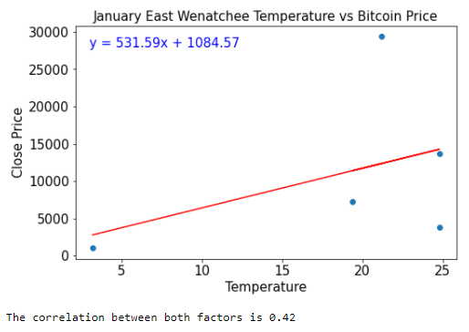
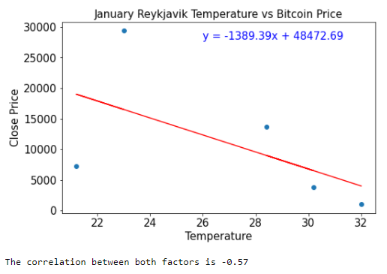
Are there environmental impacts of crypto currency: Temperature
We see similar trends when comparing the January temperatures in both locations against the Bitcoin price.
In East Wenatchee, Washington, there is a slight correlation. The temperatures generally increase as Bitcoin price increases over the years.
We were surprised to find the opposite trend in the January temperatures in Reykjavik, Iceland.
Notes:
These countries, and regional areas are being incentivized from an economic perspective to house and run these massive data mining centers (as with the case in Iceland, this business represents 1% of their GDP), but it’s to the detriment of their own microclimates. As, these data centers now account for more electricity use than all of Iceland’s homes combined.
According to local experts cited by The Wall Street Journal, keeping up with demand for electricity requires building more dams and power stations that could alter Iceland’s unique, sensitive environment.

Slide 8
Conclusions including a numerical summary and visualizations of the summary: Gas Prices

Slide 9
Implications from our findings
Nvidia stock price and Bitcoin price – strong correlation, r=.85
Gas Price –
Temperatures at Crypto Mining Centers – there is a weak correlation to rising Bitcoin prices and temperatures at major Bitcoin mining centers
What we learned
Cleaning data can take longer than expected
Formatting dates to be merged is difficult

Slide 10
Resources
Weather Data https://www.worldweatheronline.com/
The Top 5 Largest Mining Operations in the World https://thebitcoinnews.com/the-top-5-largest-mining-operations-in-the-world/
Yahoo Finance
https://finance.yahoo.com/quote/NVDA?p=NVDA&.tsrc=fin-srch
Kaggle
https://www.kaggle.com/odins0n/top-50-cryptocurrency-historical-prices
https://www.kaggle.com/kaushiksuresh147/bitcoin-tweets

